Slide 1


Presented By:
Your Name Here, Realtor®
555.555.5555 | your-email-address.com
DRE #00000000

Slide 2

Presented By:
Your Name Here, Realtor®
555.555.5555 | your-email-address.com
DRE #00000000

Slide 4
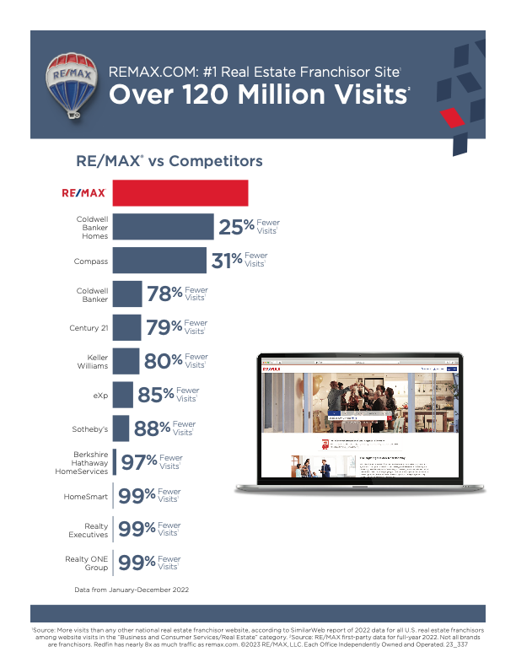

Slide 6


Slide 7


Slide 8

CLICK TO EDIT
Agent Name
Phone Number
Email
RE/MAX One
11141 Tampa Ave.
Northridge, CA 91326

Slide 9
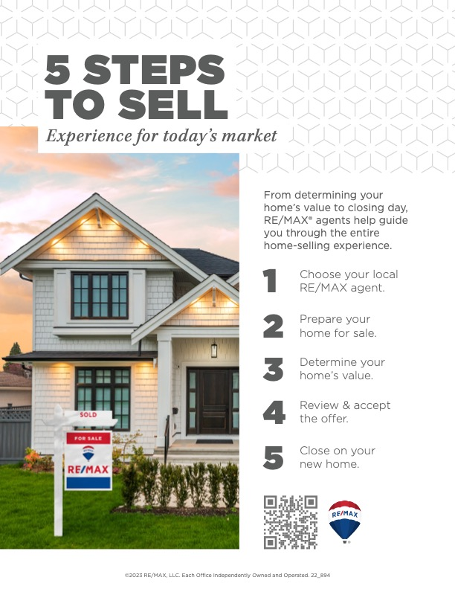

Notes:
USE A YOUR OWN QR CODE:
RIGHT CLICK ON QR CODE – SELECT CHANGE PICTURE – FROM A FILE – CHOOSE YOUR SAVED FILE

Slide 10
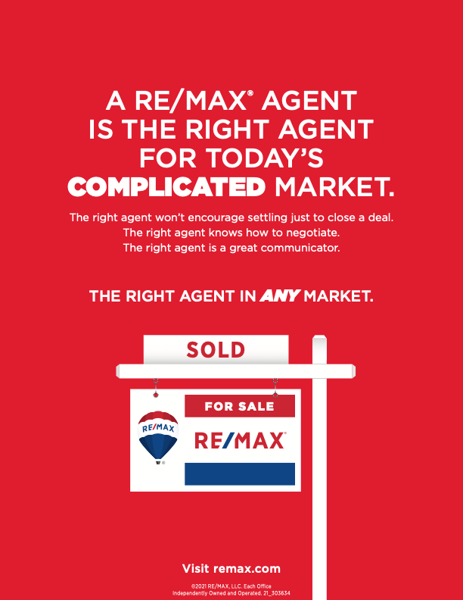

Slide 11



REDEFINING SERVICE
IN REAL ESTATE
[INSERT YOUR NAME]
REALTOR®
[INSERT YOUR BIO]

Slide 12
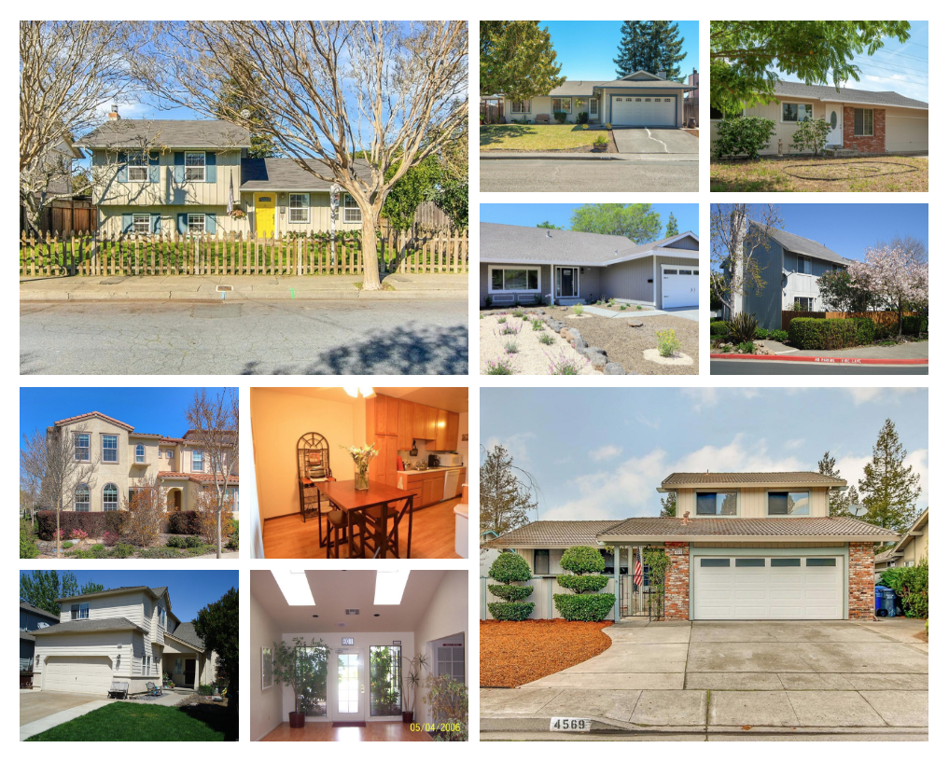
[INSERT YOUR NAME]
SALES IN 2020
# HOMES SOLD | $ VOLUME IN SALES
[INSERT # OF HOMES SOLD]
[INSERT $ VOLUME SOLD]

Slide 13
WHAT OTHERS HAVE SAID
CLIENT NAME, Buyer/Seller
[Click here to add testimonial/review]
CLIENT NAME, Buyer/Seller
[Click here to add testimonial/review]
CLIENT NAME, Buyer/Seller
[Click here to add testimonial/review]
CLIENT NAME, Buyer/Seller
[Click here to add testimonial/review]

Slide 14
WHAT OTHERS HAVE SAID
CLIENT NAME, Buyer/Seller
[Click here to add testimonial/review]
CLIENT NAME, Buyer/Seller
[Click here to add testimonial/review]
CLIENT NAME, Buyer/Seller
[Click here to add testimonial/review]
CLIENT NAME, Buyer/Seller
[Click here to add testimonial/review]

Slide 15

[INSERT CLIENT’S PHOTO, TESTIMONIAL OR REVIEW]
-INSERT YOUR CLIENT’S NAME

Slide 16

A PROFESSIONAL ON YOUR SIDE
MY ROLE
[INSERT YOUR NAME,
CONTACT INFO, PHONE]
To ensure the greatest exposure for your property to qualified buyers, I utilize “Cross Platform Marketing”
Traditional
Digital
Social
Virtual
It is my fiduciary duty to act in your best interest, always maintaining confidentiality and loyalty to you
Stand up for your best interests
Negotiate the best possible price and terms
Advise you in the real estate transaction process. Sharing the best resources and approach to solve challenges
Financial
Risk Management
Interpersonal Relations
Managing Escrow

Slide 17
UNIQUE MARKETING PLAN
MAX EFFORT, MAX RESULTS
[INSERT YOUR NAME,
CONTACT INFO, PHONE]
MY PLAN TO SELL YOUR HOME
Which may include:
[INSERT YOUR MARKETING PLAN]
Professional HDR photography
24 to 60 photos on MLS
3D Virtual Walk-in tour
Media-rich property website:
www.1234YourHome.com
Mobile Technology (QR Code)
Targeted Facebook advertising
Custom direct mail campaign
Mega Open House
RE/MAX Global Reach
Custom Sign – Buyers’ inquiries received by me
Obtain Realtor feedback
Regular Marketing activity updates

Slide 18
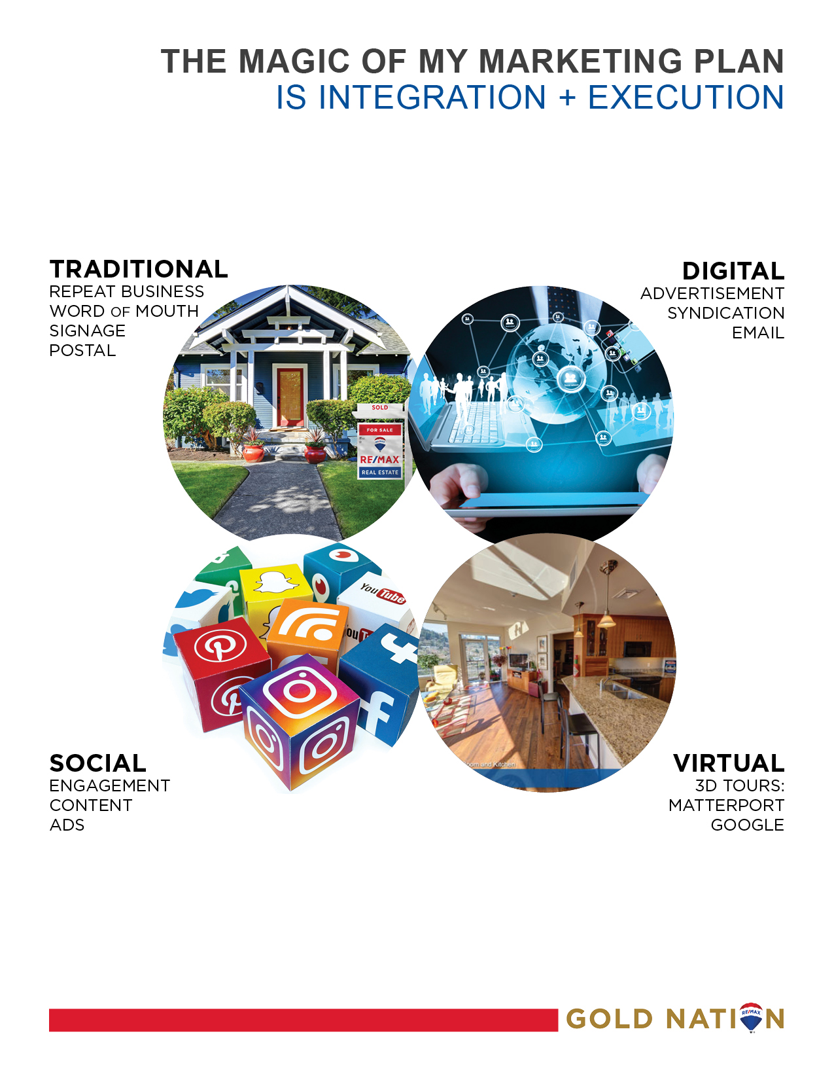

Slide 19
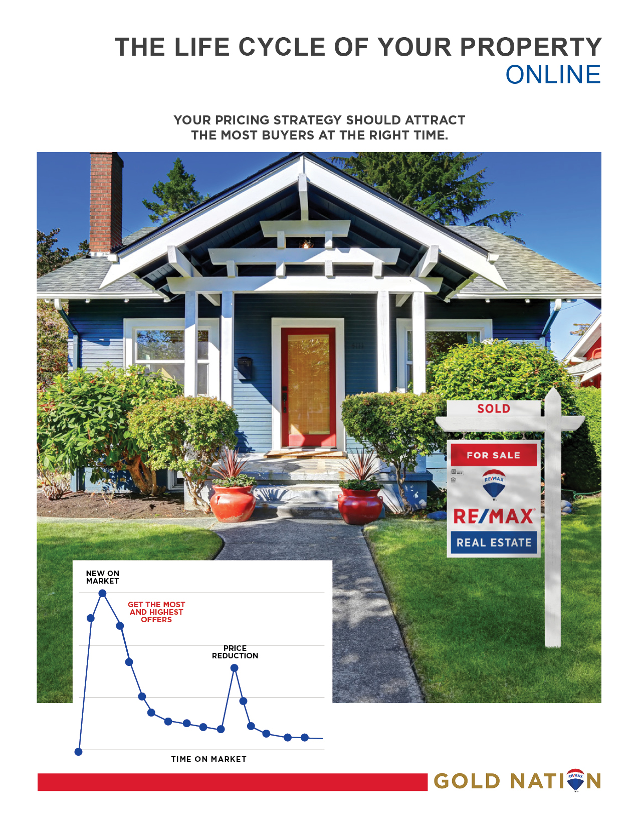

Slide 20
PROPERTY MARKET ANALYSIS
[INSERT YOUR PROPERTY MARKET ANALYSIS]

Slide 21


Slide 22


